Slide 1
Understanding Loan Default Risk in Banking
An Analysis of Key Variables Impacting Default Rates
Presented by: SHERINE ANGEL P
Date: 10th October 2024

Slide 2
Introduction to the Project
Objective
Analyse how various factors influence loan defaults.
Enhance risk assessment strategies in lending institutions.
Data Source
Dataset: Link to the dataset
Importance
Understanding loan defaults is crucial for:
Minimizing financial risk for lenders.
Improving lending practices.
Enhancing overall financial stability in the banking sector.

Slide 3
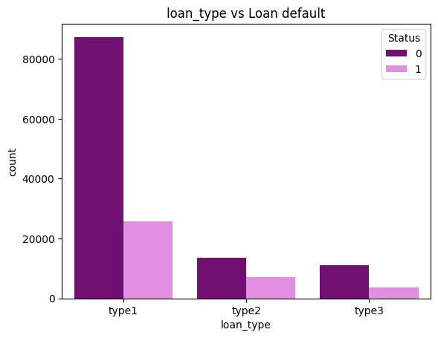
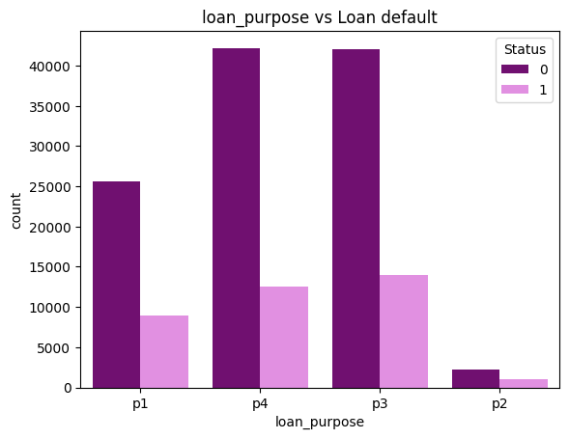
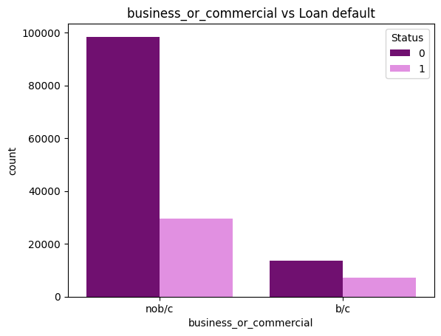
Key Variables Impacting Loan Defaults
Type-2 loans have a significantly higher count of defaulters followed by type-3 and type-1 loans. The high default rate in type-2 loans suggests a need for enhanced risk assessment criteria for this loan type. Lenders may want to scrutinize applications more closely or adjust lending terms.
P2 shows the highest count of defaulters among all loan purposes. p4 has a moderate level of defaulters, indicating some risk, but less than p1 and p3.This may suggest that while p4 loans carry risk, they are more stable compared to p1 , p2 and p3.
The "bc" category shows a significantly high count of defaulters. This suggests that loans for business or commercial purposes are associated with greater financial risk. Factors may include economic challenges faced by businesses, cash flow issues, or sector-specific risks impacting repayment.

Slide 4
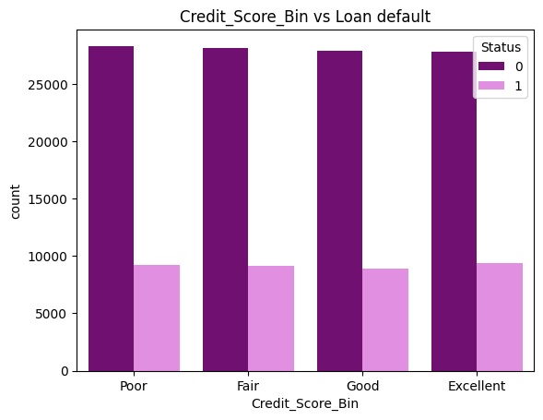
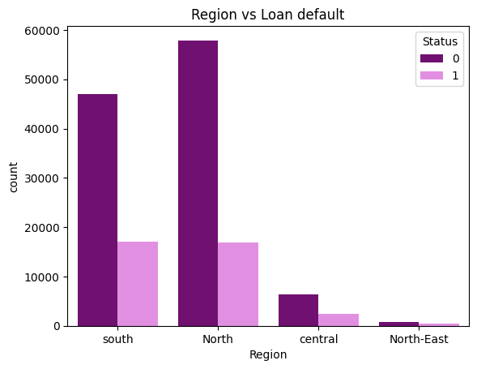
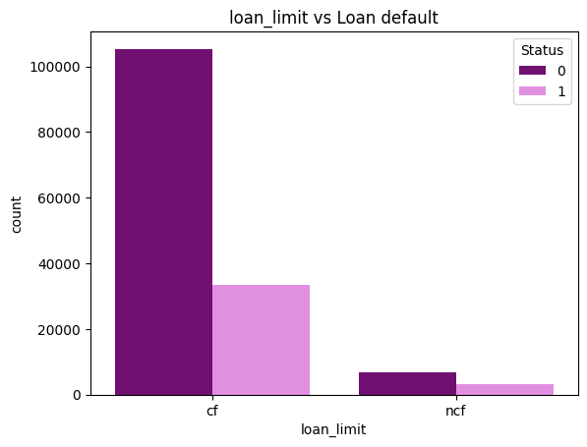
Key Variables Impacting Loan Defaults
The fact that each credit score bin has the same number of defaulters suggests that default risk is not strongly correlated with credit scores in this dataset. This could indicate that other factors (e.g., income level, debt-to-income ratio, or economic conditions) might play a more significant role in predicting defaults than credit scores alone.
The Northeast exhibits a significantly high default rate. This could indicate economic challenges specific to this region, such as higher unemployment rates, cost of living issues, or industry-specific downturns affecting borrowers' ability to repay loans. Following the Northeast, the Central region also shows elevated default rates. The South and North regions have lower default rates, indicating a more stable financial environment for borrowers in these areas.
The "Not Confirmed/Not Fixed" loans exhibit a significantly higher default rate compared to "Confirmed/Fixed" loans. This suggests that borrowers with loans that are not confirmed or fixed may face greater uncertainty in their financial situations. The lack of a fixed loan limit can lead to increased borrowing amounts, potentially overwhelming borrowers and increasing the risk of default.

Slide 5
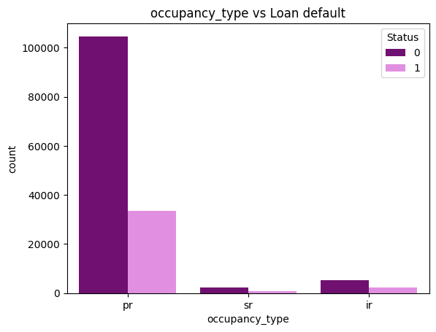
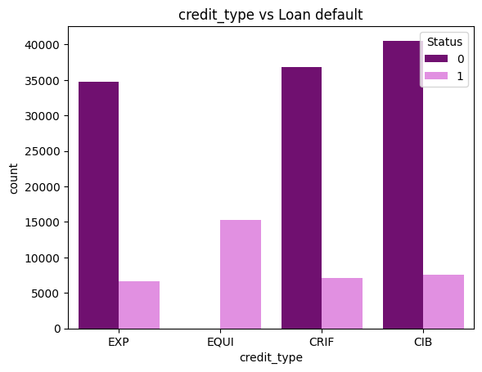
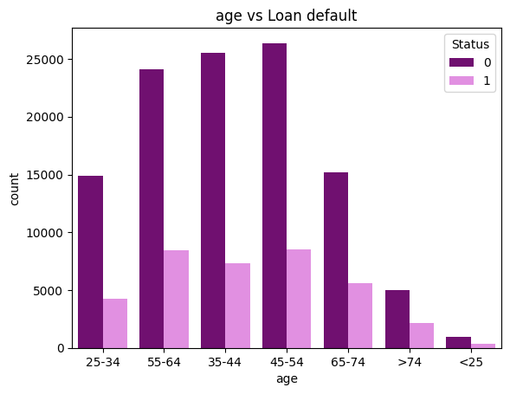
Key Variables Impacting Loan Defaults
The "Investment Residential" loans exhibit the highest default rate among the three categories. This may indicate that borrowers of investment properties are facing greater financial challenges. Borrowers in the "Single Residential" category likely have a more secure financial footing, leading to better management of their mortgage obligations. Personal Residential loans show the lowest default rates.
The "EQUI" credit type shows a significantly higher default rate compared to the other types. This may indicate that loans classified under "EQUI" are associated with higher risk profiles. Factors could include borrower characteristics, loan terms, or the nature of the loans themselves, which might be more prone to defaults.
The age group over 75 has the highest default rate followed closely by the age group under 25. Given the high default rates in the youngest and oldest age groups, lenders may need to adjust their lending criteria for these demographics. Middle-aged borrowers might have better financial resilience compared to the youngest and oldest demographics.

Slide 6
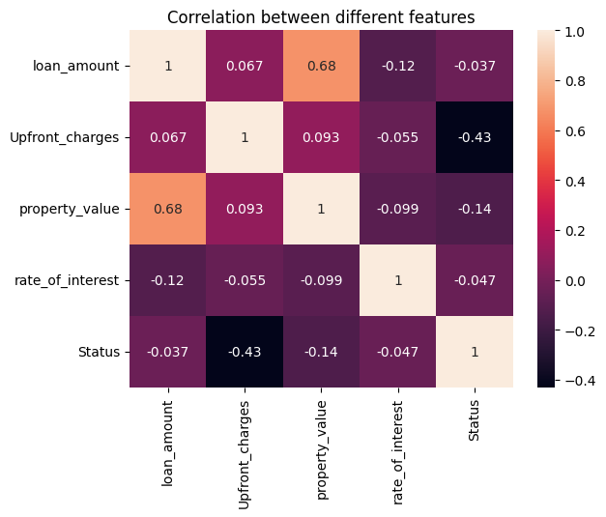
Correlation Analysis
Key Observations from Correlation Matrix
Loan Amount & Property Value:
Strong Positive Correlation (0.68): Higher property values are associated with larger loan amounts.
Upfront Charges & Default Status:
Moderate Negative Correlation (-0.43): Higher upfront charges may correlate with lower default rates, suggesting financially stable borrowers.
Property Value & Default Status:
Weak Negative Correlation (-0.14): Slightly lower default rates may be associated with higher property values.
Rate of Interest & Default Status:
Very Weak Negative Correlation (-0.05): Interest rates do not significantly impact default likelihood.
Conclusion
The correlation matrix reveals significant relationships primarily between loan amount and property value, and between upfront charges and default status. While some correlations exist, many are weak, suggesting that other factors may play a more critical role in influencing loan defaults.

Slide 7
Recommendations for Stakeholders
1. Enhanced Scrutiny for Loan Types:
- Type-2 Loans: Implement stricter risk assessment criteria for Type-2 loans due to their significantly higher default rate. Consider additional documentation or collateral requirements to mitigate risk.
- Type-1 and Type-3 Loans: Continue monitoring these loan types for potential increases in default rates, but maintain standard lending practices for now.
2. Loan Purpose Considerations:
- Focus on P2 Loans: Since P2 shows the highest count of defaulters, apply more stringent evaluation measures, including creditworthiness and repayment capability assessments, for this loan purpose.
- Moderate Risk for P3 and P1: While these categories have moderate default levels, regular reviews of borrower profiles can help identify at-risk applicants.
3. Business or Commercial Loans:
- Heightened Risk Awareness: Given the high default rate in the "business or commercial" category, increase due diligence on business loans. Assess borrowers’ financial health, cash flow stability, and sector-specific risks before approval.
4. Rethink Credit Score Usage:
- Broaden Evaluation Criteria: Since default risk does not strongly correlate with credit scores in this dataset, consider integrating additional metrics such as income level and debt-to-income ratio into risk assessment models to capture a more holistic view of borrower risk.
5. Regional Risk Assessments:
- Focus on the Northeast and Central Regions: Given their higher default rates, customize lending strategies in these areas. This could include offering financial education programs to help borrowers manage loans effectively.
- Monitor Economic Indicators: Stay vigilant about regional economic trends that may impact borrower repayment abilities.

Slide 8
Recommendations for Stakeholders
6. Fixed vs. Non-Confirmed Loans:
- Adjust Lending Terms: For "Not Confirmed/Not Fixed" loans, consider offering more conservative lending terms or additional financial counselling to ensure borrowers are aware of potential risks associated with variable loan limits.
7. Investment Residential Loans:
- Specific Evaluation for IR Loans: Since "Investment Residential" loans exhibit high default rates, require thorough assessments of borrowers’ financial situations and investment plans to ensure they can manage their loans effectively.
8. Targeted Strategies for Age Demographics:
- Adjust Lending Criteria for Younger and Older Borrowers: Given the high default rates in the under 25 and over 75 age groups, develop tailored lending strategies that account for their unique financial situations, such as providing financial literacy programs for young borrowers and considering income stability for older borrowers.
9. Enhance Risk Assessment Models:
- Focus on Upfront Charges: Given the negative correlation between upfront charges and default rates, consider incorporating upfront charges into risk assessment models. Higher upfront charges could indicate more committed borrowers, potentially lowering default risk.
10. Property Value Considerations:
- Adjust Lending Criteria: Since higher property values correlate with larger loan amounts and potentially lower defaults, consider adjusting lending criteria to prioritize properties with higher values, which may be associated with lower risk.

Slide 9
Summary of Risk Category Effectiveness
Based on the insights derived from the dataset, a risk score has been developed to categorize individuals into different risk groups. This categorization has been validated against the "Status" column, which indicates whether an individual is a defaulter (1) or normal (0).
Loan Defaulters:
The risk category has effectively classified 100% of defaulters in the “Critical" risk category.
Additionally, it has classified 90.75% of defaulters in the “High" category.
Non-Defaulters:
86.17% of non-defaulters have been classified in the "Informational" category.
72.37% are classified in the "Low" risk category.
Next Steps
Monitor Outcomes:
Continuously evaluate the effectiveness of implemented strategies.
Future Research:
Explore additional factors influencing loan defaults and adjust strategies accordingly.
Conclusion
Enhanced risk assessment strategies can significantly reduce loan defaults.
Data-driven insights allow for more informed lending decisions.
Tailored approaches for high-risk demographics and loan types are essential for financial stability
Thank You!

